Slide 1


Type Checking in Programming Languages
PRESENTED BY Amha kifle , JANUARY 4, 2026

Slide 2

Understanding Type Checking in Programming
COMPILER SAFETY INSPECTOR
Type checking acts as a compiler and runtime safety inspector, preventing illogical operations, like adding a string to a number, ensuring program correctness.

Slide 3

Two Main Approaches to Type Checking
STATIC TYPE CHECKING
Static type checking occurs at compile time, ensuring that errors are caught before the program runs, enhancing safety and reliability.
DYNAMIC TYPE CHECKING
Dynamic type checking happens at runtime, allowing for more flexibility but potentially leading to errors that only appear during execution.

Slide 4
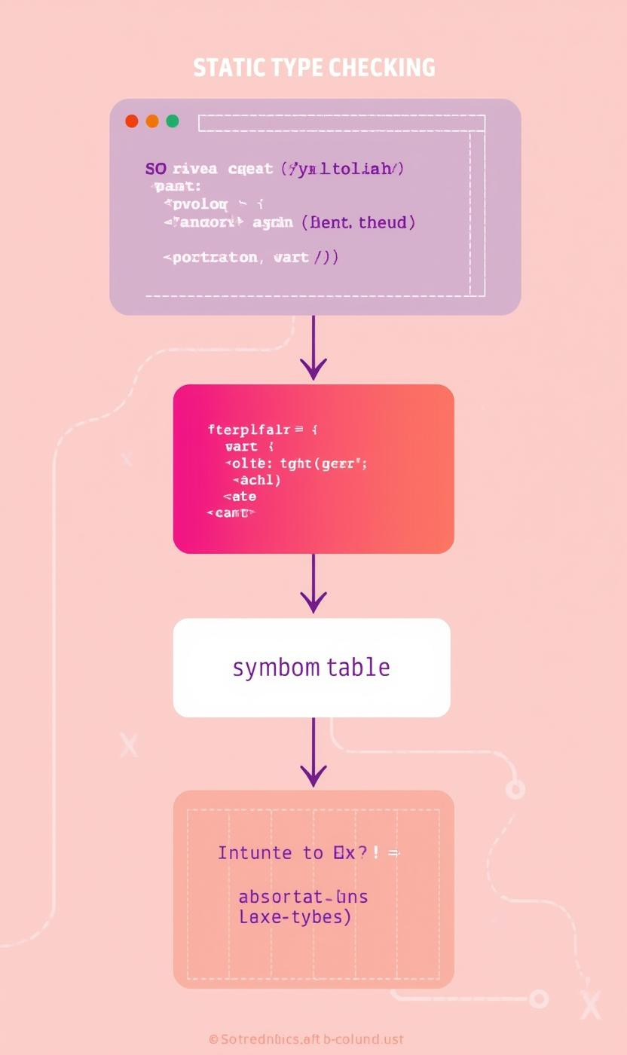
Understanding Static Type Checking Mechanism
HOW IT OPERATES
Static type checking involves the compiler analyzing the source code before execution, utilizing a Symbol Table and Syntax Tree to track types effectively.

Slide 5
Advantages of Static Type Checking
EARLY ERROR DETECTION
Static type checking allows developers to catch errors before execution, ensuring that issues are identified and resolved during compile time.
SUPERIOR PERFORMANCE
With no runtime checks required, static type checking can enhance performance, making applications run more efficiently and reducing overhead.
BETTER DOCUMENTATION
The explicit type declarations in static type checking lead to clearer code documentation, making it easier for developers to understand the codebase.

Slide 6
Disadvantages of Static Type Checking
RIGIDITY AND FRUSTRATION
The strict enforcement of types can lead to frustration among developers, especially when they face challenges due to unexpected compiler errors.
VERBOSITY
Static type checking often requires lengthy type declarations, resulting in verbose code that can be cumbersome to read and maintain over time.
LONGER COMPILATION TIMES
Due to the extensive checks performed at compile time, static type checking can result in longer compilation times, slowing down the development process.

Slide 7
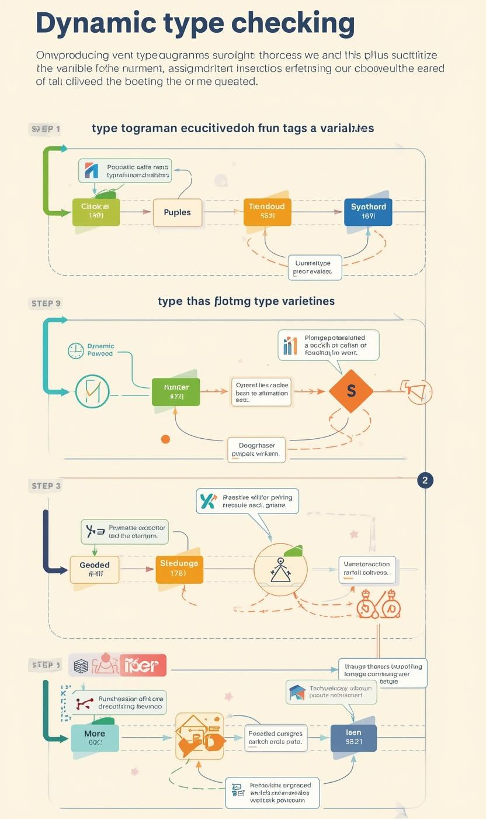
Understanding Dynamic Type Checking Mechanisms
RUNTIME TYPE VERIFICATION
Dynamic type checking validates variable types during execution, ensuring correctness by raising errors when operations involve incompatible types, enhancing runtime safety.

Slide 8
Advantages of Dynamic Type Checking
RAPID PROTOTYPING
Dynamic type checking enables rapid prototyping, allowing developers to quickly test and iterate on ideas without the constraints of a strict type system.
HIGH FLEXIBILITY
With dynamic type checking, developers enjoy high flexibility in their code, easily adapting variable types and structures during runtime without extensive modifications.
CONCISE CODE
Dynamic typing promotes concise code, reducing boilerplate declarations and enhancing readability, which helps developers focus on logic rather than type specifics.

Slide 9
Disadvantages of Dynamic Type Checking
RUNTIME CRASHES
Dynamic type checking may lead to runtime errors that occur late, potentially causing unexpected program crashes during execution.
PERFORMANCE OVERHEAD
Constant type checks can add performance overhead, resulting in slower execution times compared to statically typed languages with earlier error detection.
WEAKER IDE SUPPORT
Development environments often provide less robust support for dynamic languages, leading to weaker tools for code completion and error highlighting.

Slide 10
Comparison of Type Checking Methods
TIMING DIFFERENCES
Static type checking occurs at compile time, allowing early error detection before code execution. This prevents runtime failures and improves reliability.
ERROR DETECTION MECHANISMS
Dynamic type checking verifies types during runtime, enabling greater flexibility. However, this can lead to late errors that may disrupt program flow.

Slide 11
Code Verbosity and Tooling Insights
CODE VERBOSITY
Static type checking often requires explicit type declarations, leading to more verbose code compared to dynamic type systems, which are generally more concise.
TOOLING & AUTOCOMPLETE
Static typing provides superior IDE support with better autocompletion features, while dynamic typing may struggle with intelligent suggestions due to runtime variability.

Slide 12

Language Examples
STATIC
DYNAMIC
HYBRID
Languages like C, C++, Java, and Rust use static type checking, enforcing type constraints at compile time for safer code execution.
Dynamic type checking is employed by languages such as Python, JavaScript, Ruby, and PHP, allowing for more flexibility and rapid development.
TypeScript and Kotlin represent modern trends in hybrid typing, blending static and dynamic features to enhance safety while maintaining flexibility in coding.

Slide 13
Choosing the Right Type
STATIC
DYNAMIC
GRADUAL
Static type checking is ideal for large systems where performance and reliability are critical, ensuring errors are caught at compile time.
Dynamic type checking excels in rapid development scenarios, allowing for quick iterations and flexibility, which is crucial in fast-paced environments.
Gradual typing presents a modern hybrid approach, combining strengths of both static and dynamic systems to enhance flexibility while maintaining safety.

